Slide 1
XML Technologies
Hannu Sirén G2458
Jarmo Puttonen F0899

Slide 2
Summary
Software that learns to search specific news from reddit
User scores pages either useful or useless
Each vote calibrates keywords
Software calculates scores for pages
Score is calculated from keywords

Slide 3
Important Libraries
Multiprocessing
Threading
Httplib2
BeautifulSoup

Slide 4
Conf.xml
<data>
<sites>
<site>http://www.reddit.com/r/programming/</site>
</sites>
<params>
<search_param>c++</search_param>
</params>
<pages>1</pages>
<mixml>results/data.xml</mixml>
</data>

Slide 5
Elements
Parent
Child
UI
Updater

Slide 6
Parent
Loads xml confs
Starts new thread
Thread starts new child processes
Thread communicates with child processes
Combines child processes results as one xml
Starts browser

Slide 7
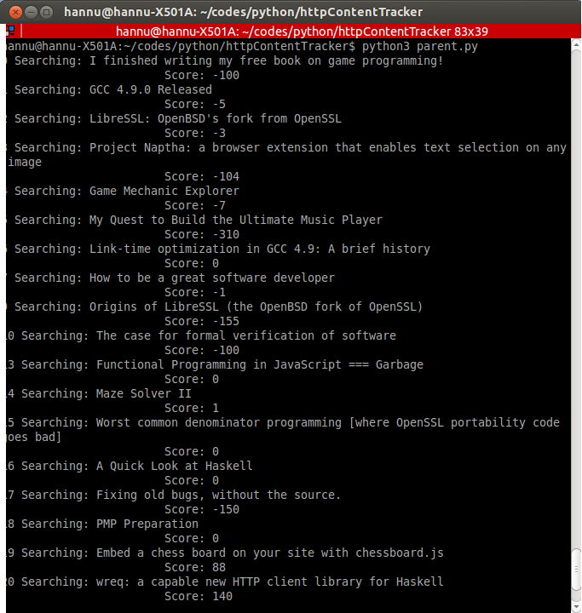

Slide 8
Child
Loads reddit page
Get links
Check if link is unique
Follow links
Get page data
Save page data
Calculate score
Create xml file containing results

Slide 9
UI
HTML Page
Javascript loads xml data
Presents data dynamically
Inputs are send to server
Server calls for Updater
Repeat

Slide 10
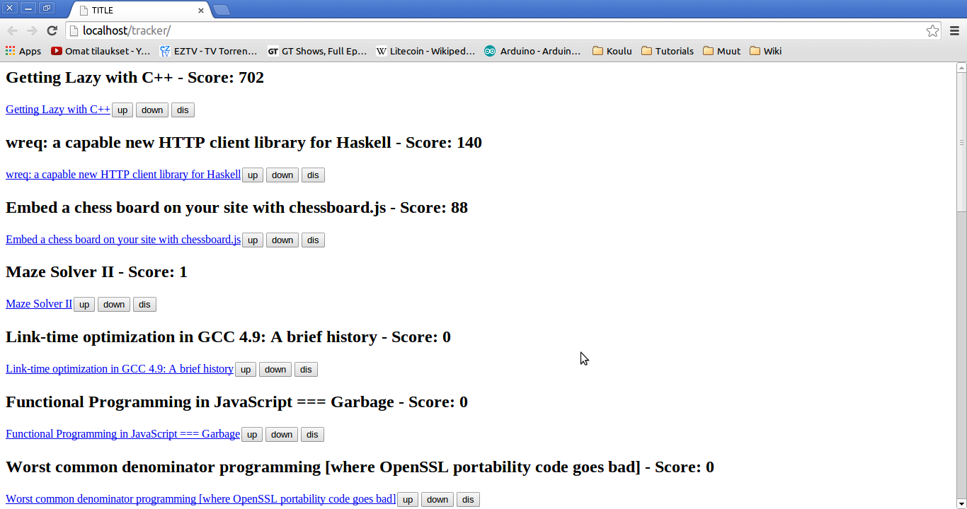

Slide 11
Updater
Is called by server with vote and ID
Load page data corresponding to ID
Store link, title, headers and chapters to words.xml
Recalculate keywords
Remove loaded page data, and xml element from results
Return to UI

Slide 12
